Slide 1

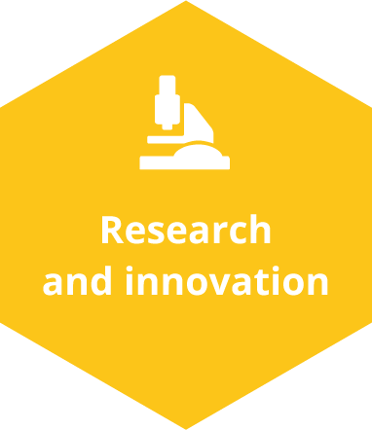

Policy Learning Platform Matchmaking
“Southern Catalonia Region of Knowledge”: fostering multi-actor projects
From strategic thinking to down to earth collaboration (Asturias RIS3)
Online matchmaking
Online, 18 March 2022

Slide 2
Paz Palacio, IDEPA, Asturias, Spain
paz@idepa.es

Slide 3
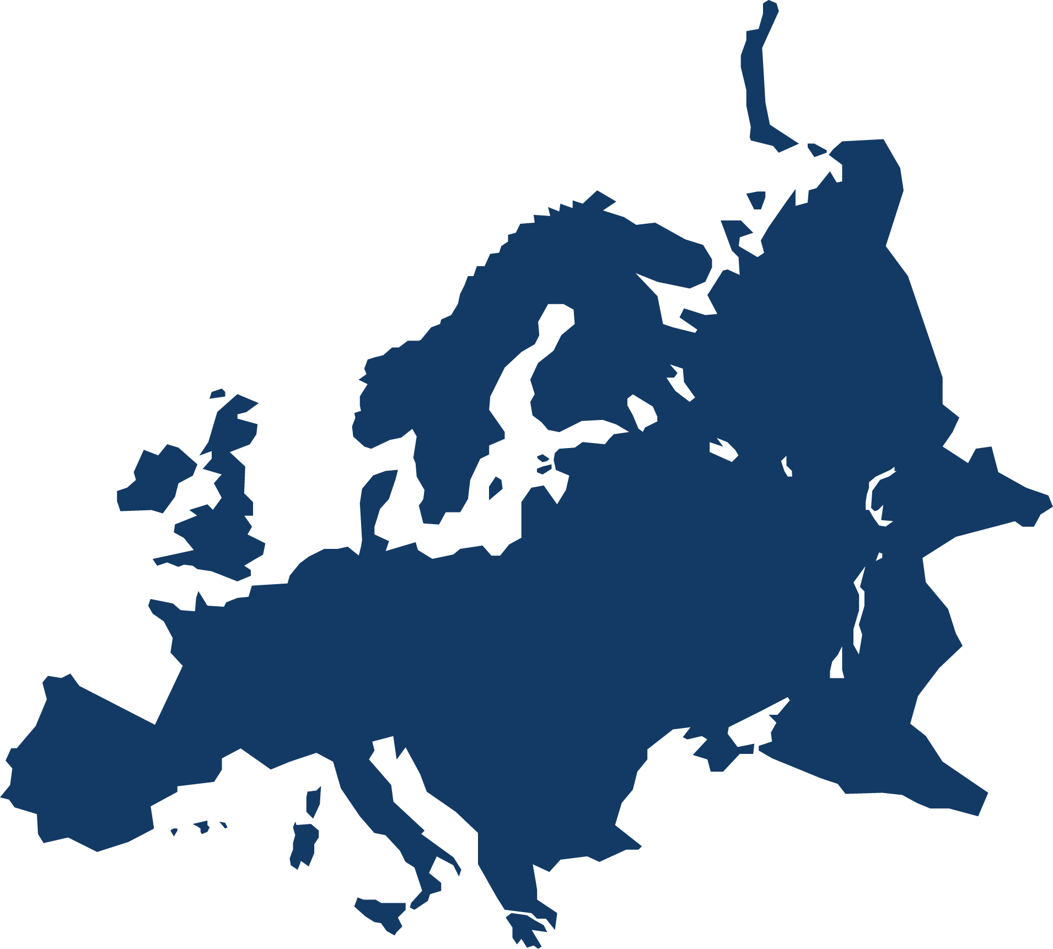



Your Region? ASTURIAS
1 M POPULATION . 19,7 % INDUSTRY. 2 K UNIVERSITY RESEARCHES. 33,3% LAND PROTECTION
Specialisation in process industry 33 % of industrial employment
Multinationals represent 32 % of sales
Regional leadership on social and health protection
R& D private investment below national average
EU R&D funds returns by scientific actors needs to be improved

Slide 4
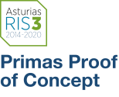


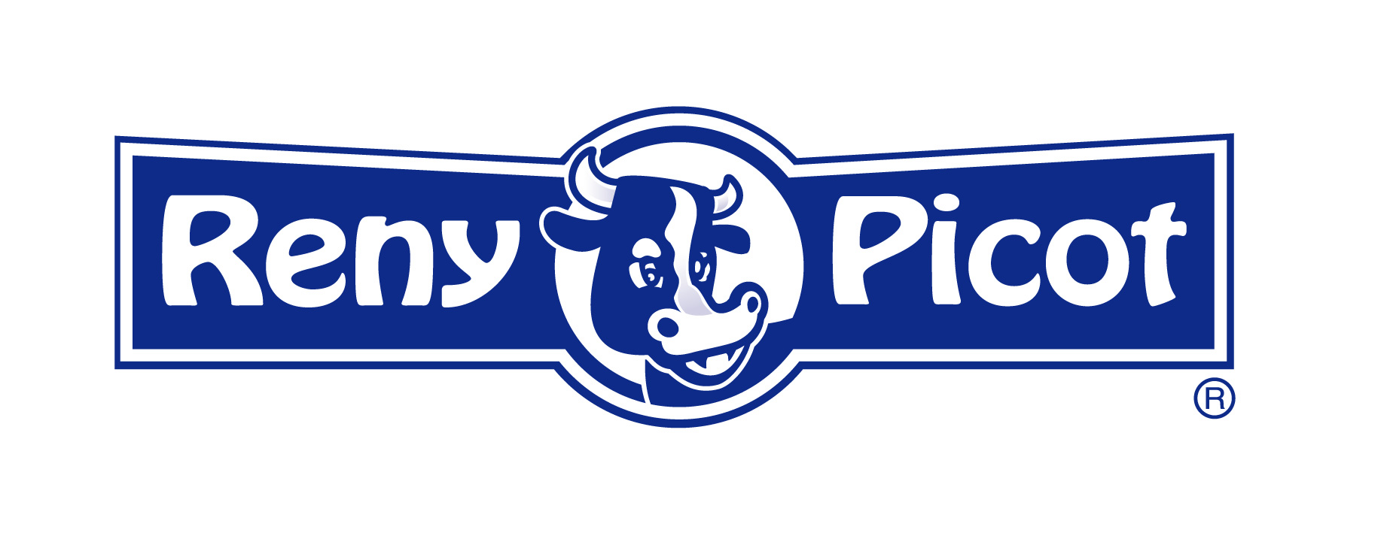


multi-actor project (1)
3 ACTORS: UNIVERSITY OF OVIEDO; REGIONAL GOVERNMENT (IDEPA); PRIVATE COMPANY
From strategic thinking to down to earth collaboration (Asturias RIS3)
PRIMAS PROOF OF CONCEPT innovative public-private partnership to support open innovation in leadership companies.
The researches received 30.000 € (50% cofinanced) and have 12 moths to do validate their research in industriallly relevant environment.
BENEFITS : co-create a multi-collaborative tool. (1) working on our scientific strengths (2) and offer continuity to research activities (3) Involve (as a partners) big and medium companies (commitment) as a RADAR
Not follow conventional legal formulas (contracts or subsidies) something new (combining elements) that will allow public-private collaboration, and that will focus on outcomes

Slide 5

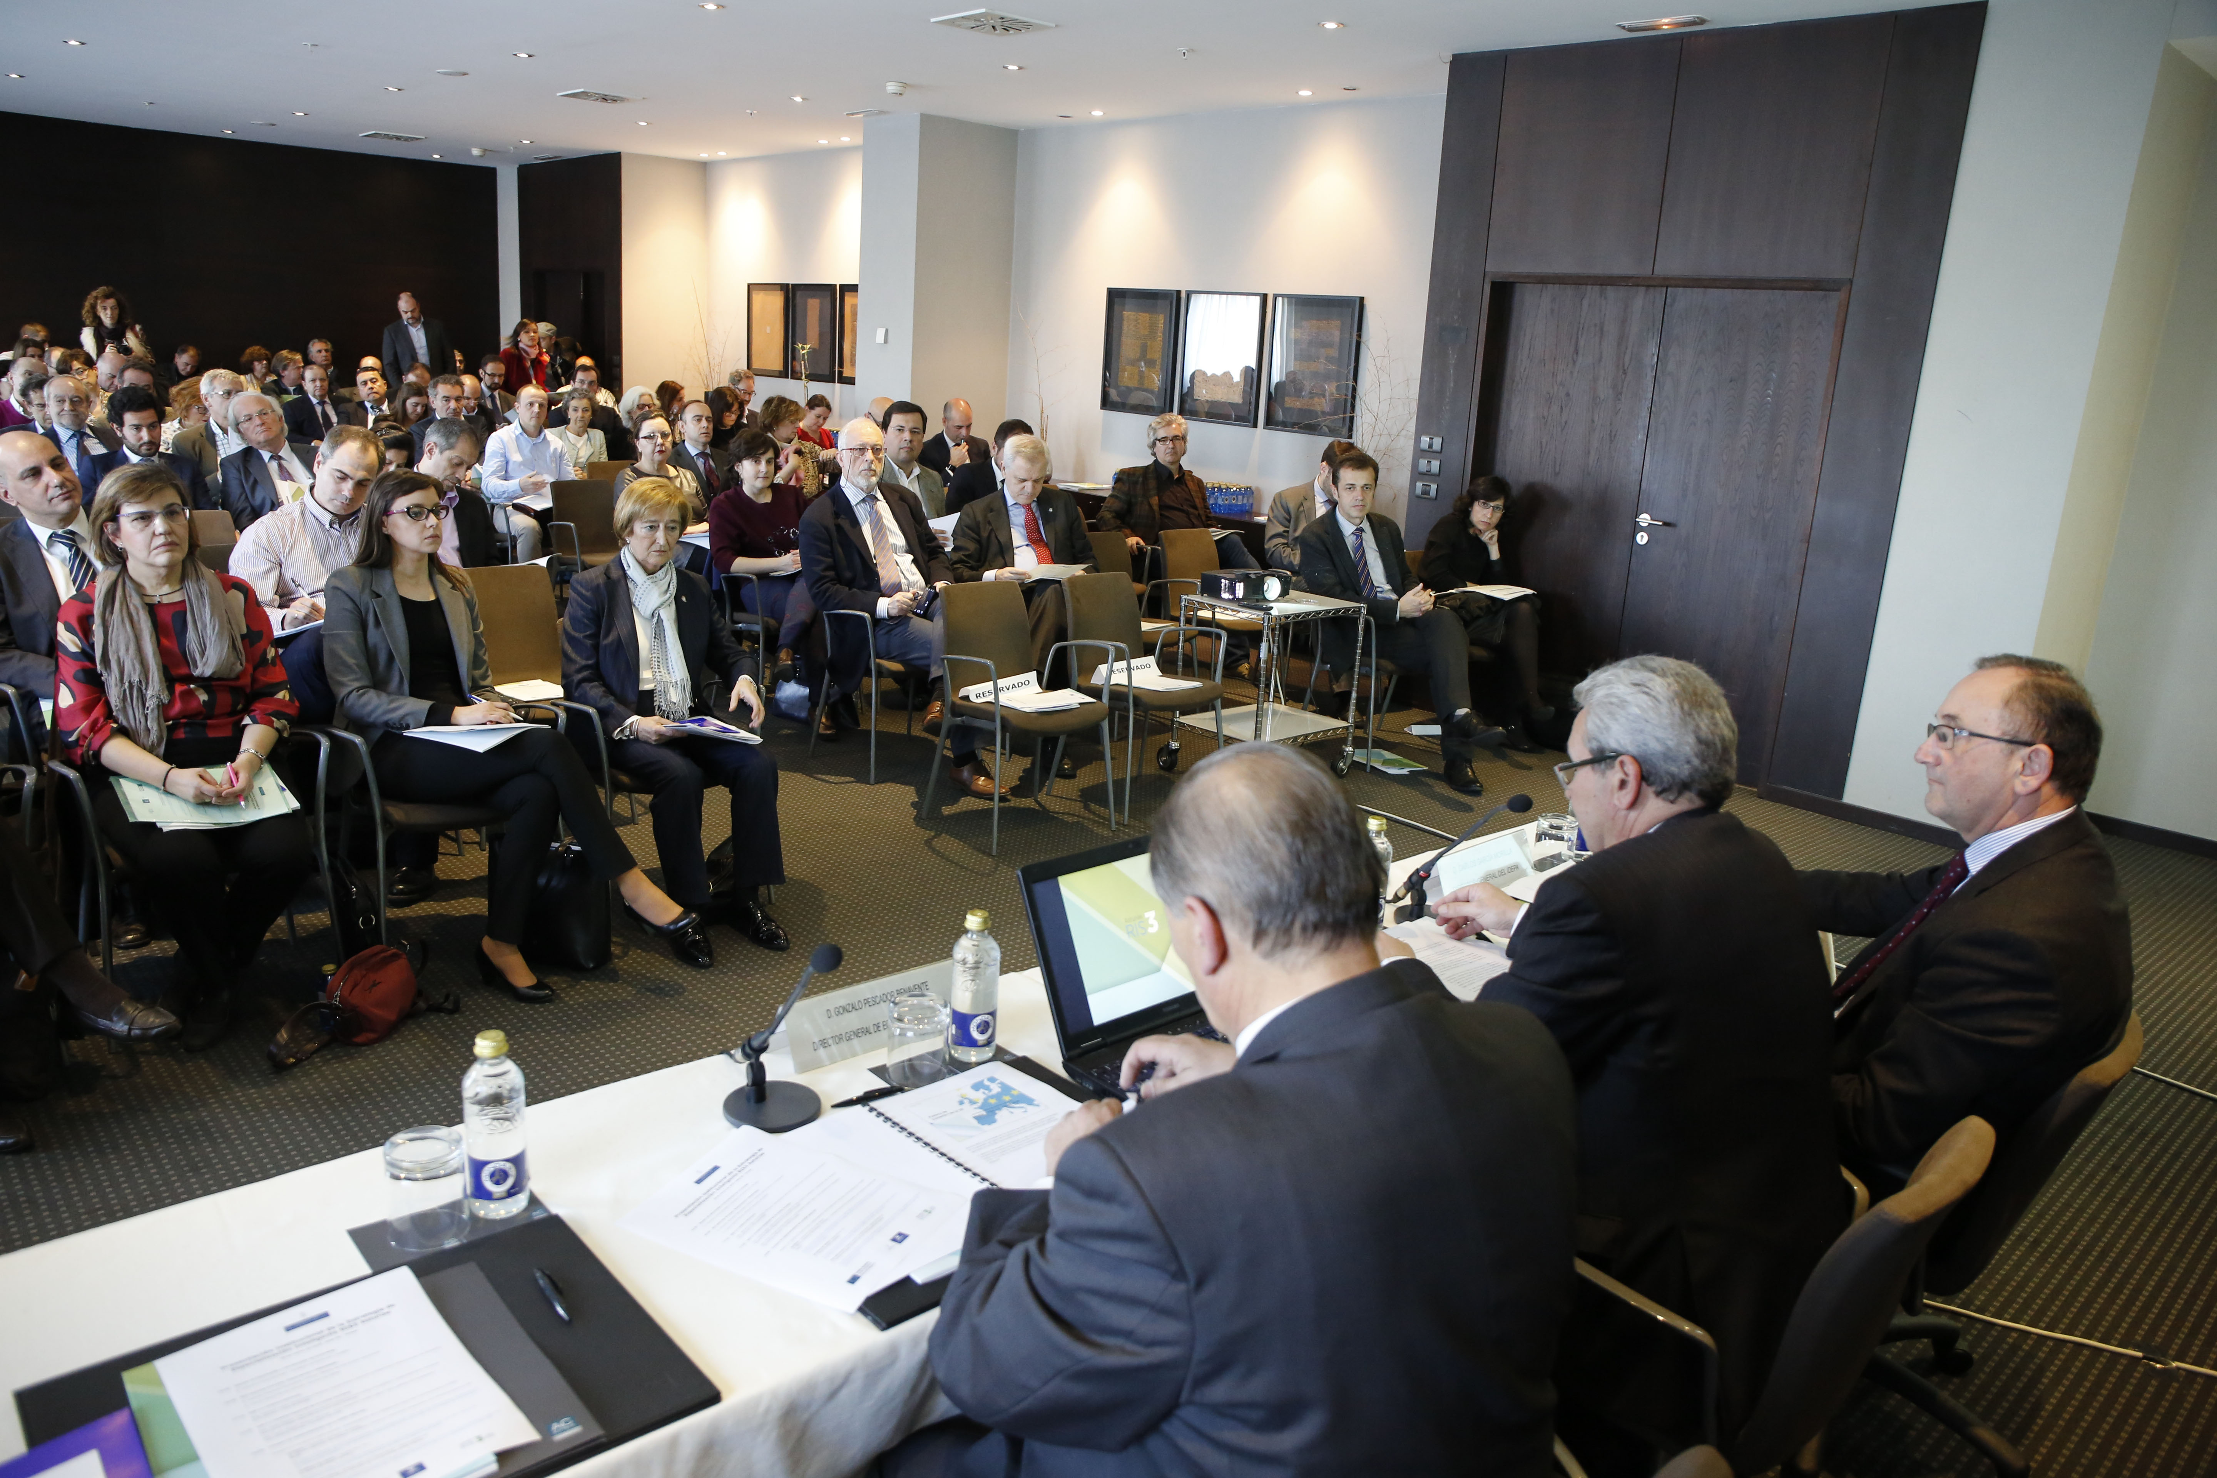
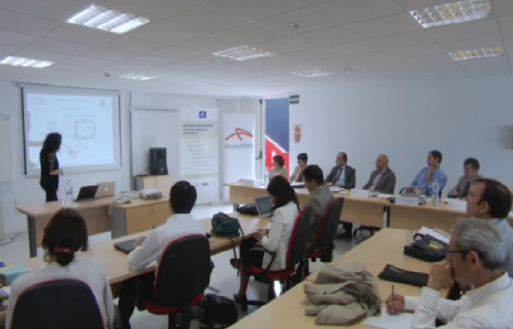
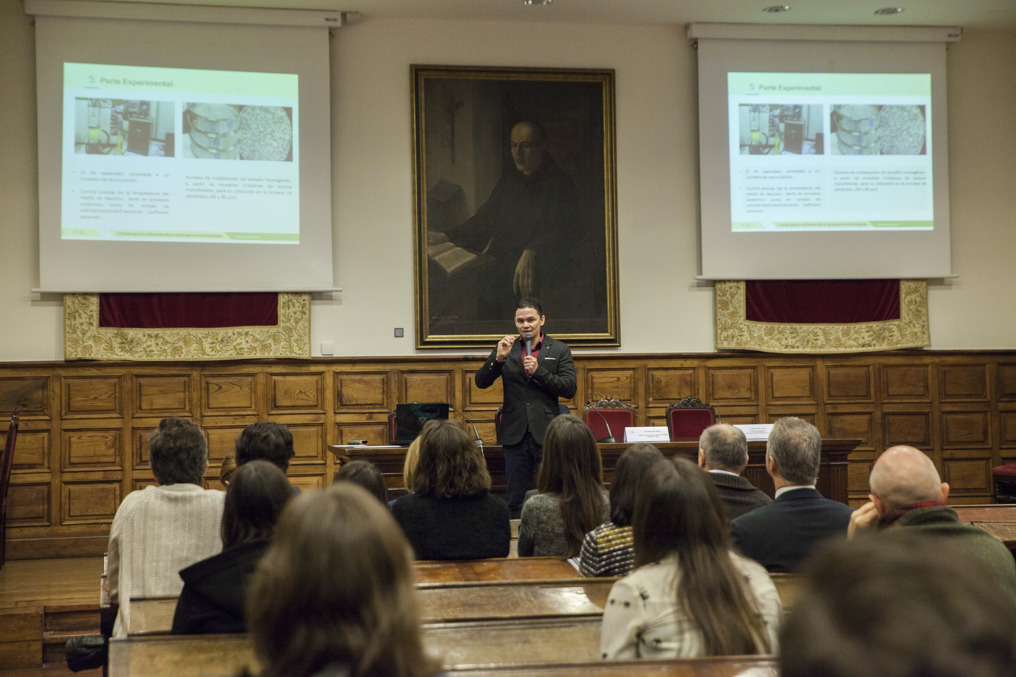
Details (2)
DELIVERABLES / WORDING : AGREEMENT . ACCEPTANCE. CALL. VISIBILITY
Call : company identifies the research priorities and its internal challenges (visits in situ)
3 months for applications.
Public defense Acto de defensa before the Jury
1 year after. Deliverance of a final report (and summary for difusión purpuse)
Public presentation of results
1 year to reach and agreement (preference) (IP)
.

Slide 6
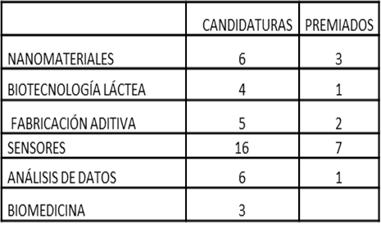
Results (3)
Difficulties encountered
It is required medium or big companies with own R&D activity that are willing to partner and contribute money without a clearly predefined return. PoC should be understood by them as a radar to access to new knowledge ,as a contribution to the territory and reinforcement of local ecosystem.
Evidence of success
There are research and innovation results achieved during the validation period. Furthemore, the impact goes beyond , some of the researchers of previous editions already had the opportunity to continue the collaboration with the company in different ways: public-private scientific publications , new research or demostration proyects ...
Future
scaling up (joint calls); ip improvements, visibility and following of impacts (fidelity , club)
44 | 14
4 + 420.000 €

Slide 7
THANK YOU!
Online, 18 March 2022

