Slide 1



Better RIS3 Governance
Roadmap for the Regional Agenda of Sustainable Materials for Asturias
Paz Palacio Fernández / IDEPA
Thematic Webinar
22 October 2019 | Online

Slide 2




1.
The project wants to improve the implementation of RIS with focus on chemical related topics with the help of interregional exchange of experiences and mutual learning between public authorities from seven European chemical regions.
.
From 1 Apr 2016 to 31 Mar 2021
2,2 M €

Slide 3
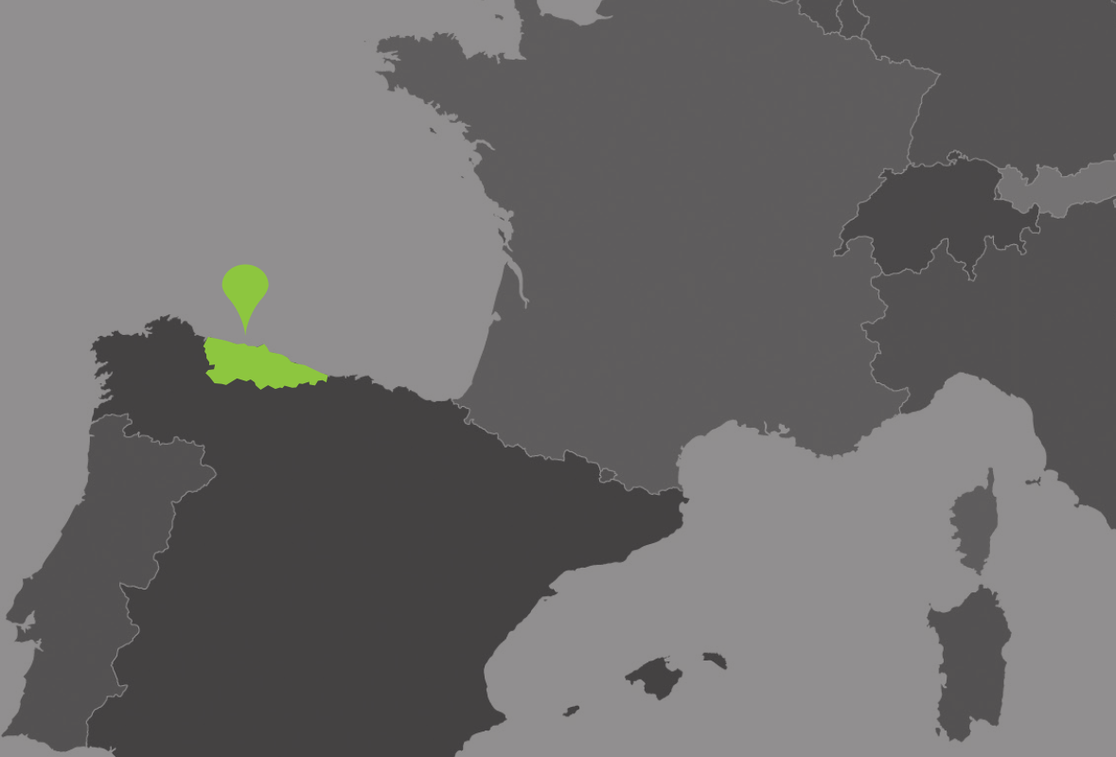
2. Institutional Context
SURFACE 10.604 Km,
POPULATION 1.081.487
21 % GPD INDUSTRIAL
The Economic Development Agency of the Principality of Asturias (IDEPA) is a Public Body, dependent on the Asturian Regional Government. Minister of industry and employment is our president.

Slide 4

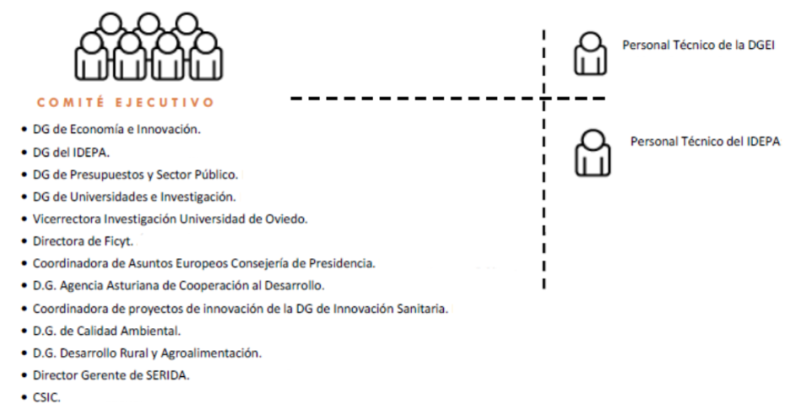



3. The RIS3 Governance
Policy mix
Asturian Council of Science Technology and Innovation
Agendas

Slide 5
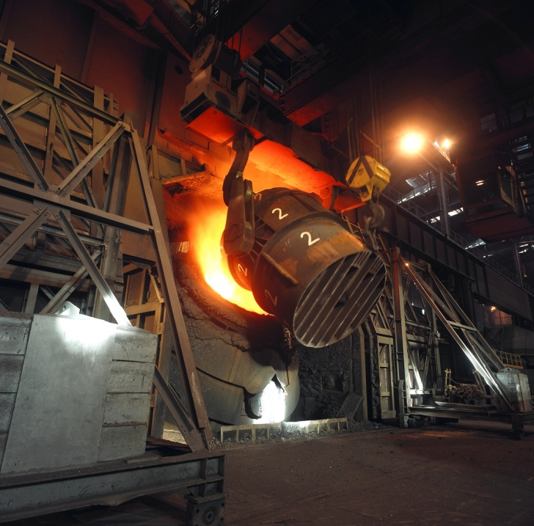
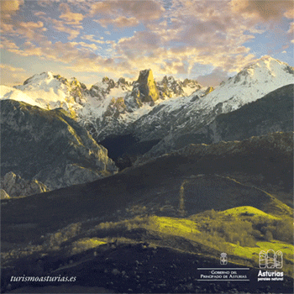
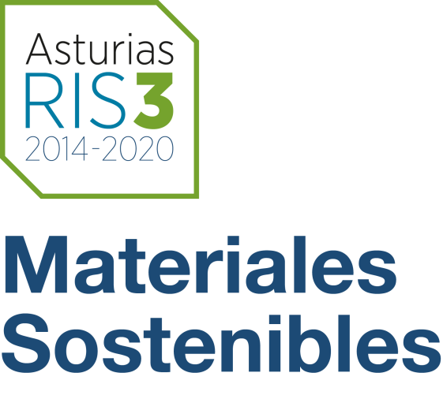
4.a Roadmap
Action Plan
Regional Agenda of R&D of sustainable materials. The topic is related to circular economy concept implemenented in the full lifecycle of the basic materials sector
First step: Roadmap identifying the value chains that represent regional specialization.
Decresing the impact of residues
Try to enlarge the lyfe cycle of existing assests
ASTURIAS has the challenge of addressing the transition of the process industry by decreasing the impact of residues in the Natural Paradise

Slide 6



4.b Stakeholders and timeline
Looking for critical mass
58 participants | 22 companies | 5 R&T centres
ASTURIAS RIS3 2015
SEPT. 2016 WG. ROADMAP
SEPT. 2017 FINISHED
WG meetings: 22 Sept. ´16; 22 Feb. ´17; 29 June ´17

Slide 7
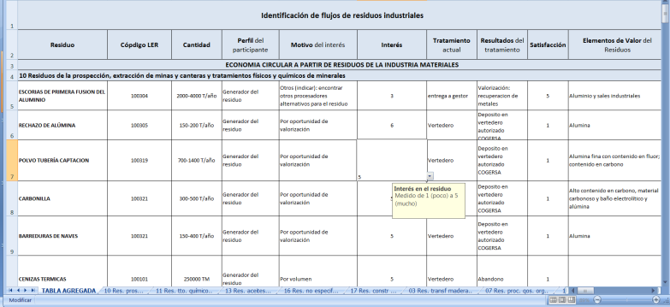
4.c The survey
Value chain:
Waste-Technology-Markets
Output: 7 value chains and 4 specialisation markets (cement, ceramic, fertilizers and chemical products)
+ debate about socio-economic challenges in the region

Slide 8
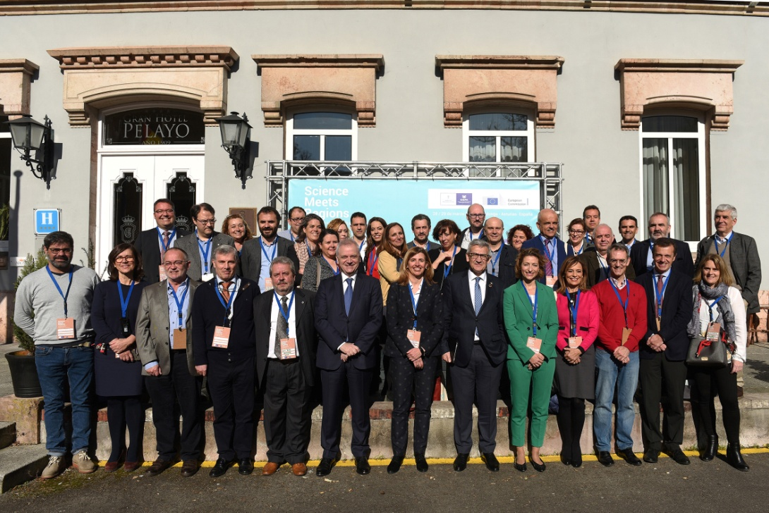
5. Unforeseen outcomes 2019
    28 / 29 March Innovation Camp
A natural paradise in modern times: adressing industrial transistion throug circular economy. www.sciencemeetsasturias.es
Inventory of regional public or private R&D infraestuctures grouping them around comprehensive waste recovery pathways (nodes of a future Circularity Hub in Asturias:SPIRE)
Notes:
(4 specialisation markets: manufacture of clincker, cement and concrete, manufacture of refractory materials, manufacture of fertilizers and diversification markets)

Slide 9
6. Recommendations
  Involve yourself in the technical work (do not outsource all the tasks).
  Build up the Key Partnership: Industry should lead the process. (PPP) Involvement of companies and of the right person (R&D and environmental). Strong legal barriers: involve Ministrer of Environment
  Time: between 6 m. and 1 y. (discovery process..)
  Keep traceability from the beginning so you can trace inexpected parallel results (new collaborative projects)
Don’t forget to meet the interest of the industry looking for “business sense”
Notes:
CONSTRUIR SOBRE CONEXIONES EXISTENTES Y RECURSOS COMPATIDOS Participatory process !!!!!!

Slide 10

#MaterialesSostenibles#AsturiasRIS3
@asturiasRIS3
paz@idepa.es

Slide 11

Better RIS3 Governance - Webinar
© Pexels
?

