Slide 1




C-SINK (Actions Required to Secure the Largescale Deployment of the Leading CDR Approaches to Meet EU Climate Targets)
HORIZON.2.5 - Climate, Energy and Mobility
HORIZON.2.5.1 - Climate Science and Solutions
Call HORIZON-CL5-2022-D1-01-01-two-stage - Carbon Dioxide Removal (CDR) approaches
HORIZON Research and Innovation Actions (RIA) (4 years, 2023 to 2027)
Grant agreement ID: 101080377

Slide 2
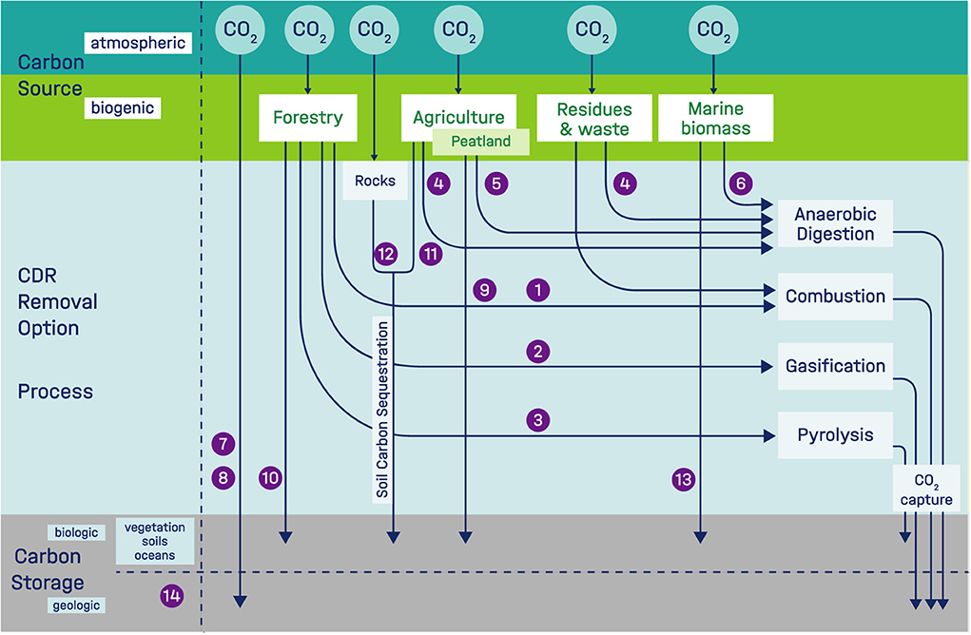
Context: CDR and global warming
Global warming
Mitigation of GHG not enough
Removal of atm. CO₂ necessary to compensate
CDR tech. potential
Uncertainties about CDR technologies
Carbon-neutrality???
(Borchers et al., 2022. Front. Clim. 810343)
Techno-economic review of CDR portfolio needed

Slide 3
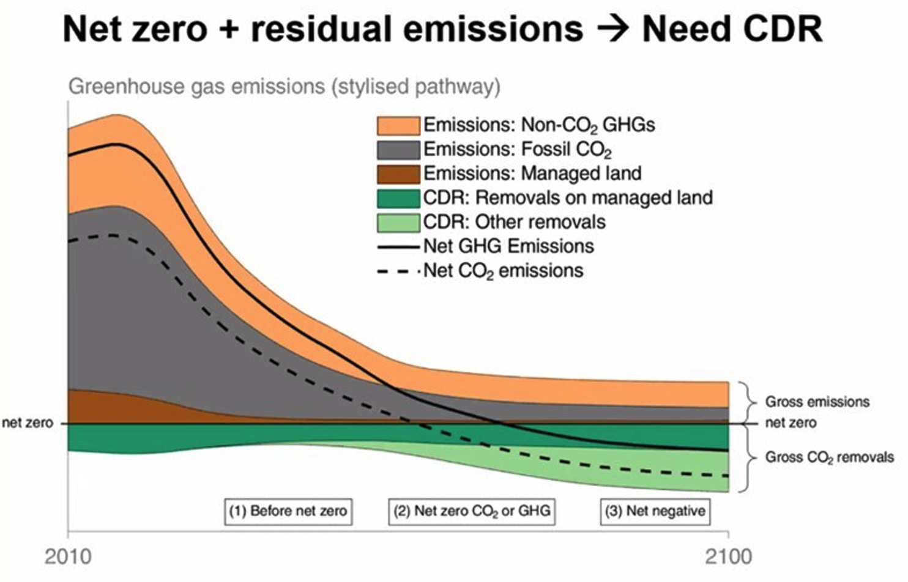
General Objectives
Comprehensive scientific assessments will be made of the various CDR approaches, in terms of (a) their potential uptake of CO₂, and (b) their safety and other impacts over time.
C- SINK will support a standardized and transparent European CDR market with accounting methodologies based on robust Monitoring, Reporting and Verification (MRV) pre-standards and policy strategies.

Slide 4






Context (CDR technologies)
CO₂ fixation by plants and microorganisms (BCO₂)
Afforestation (AF)
Biochar (BC)
Artificial soils (AS)
Biochar + carbon capture and storage (BCCCS)
Bioenergy with Carbon Capture and Storage (BECCS)
Enhanced weathering (EW)
Potentials for carbon offsetting
Permanence
Environmental & social impacts
Large-scale potential

Slide 5
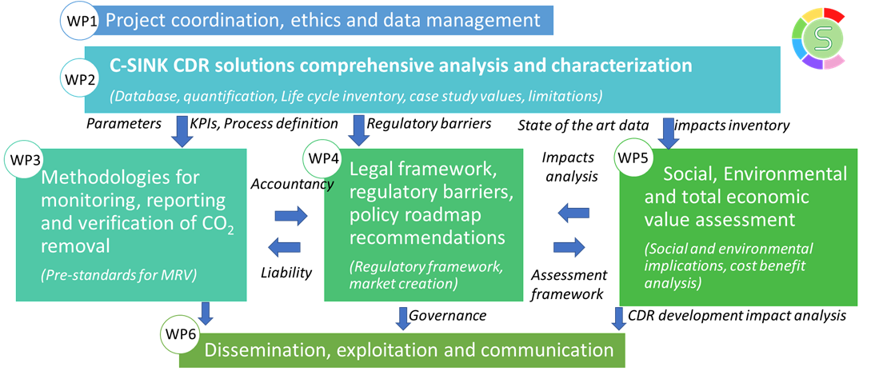
C-Sink Structure

Slide 6
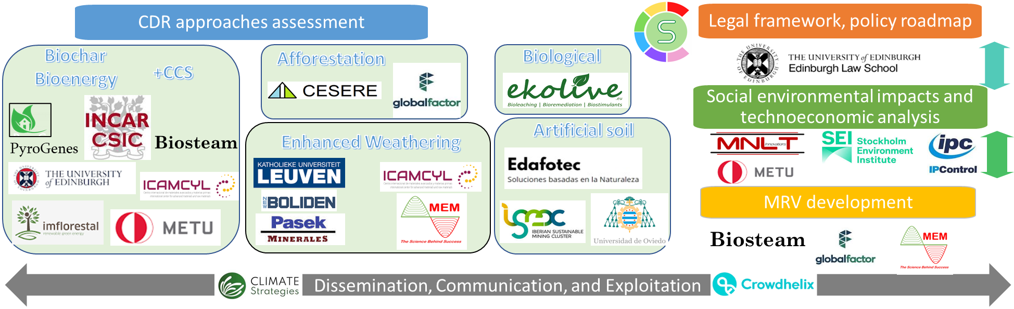
C-Sink Partners
24 entities from 11 different European countries
15 Industries & SMEs
2 Industry-driven clusters and foundations
3 Research Centers
4 Universities

Slide 7
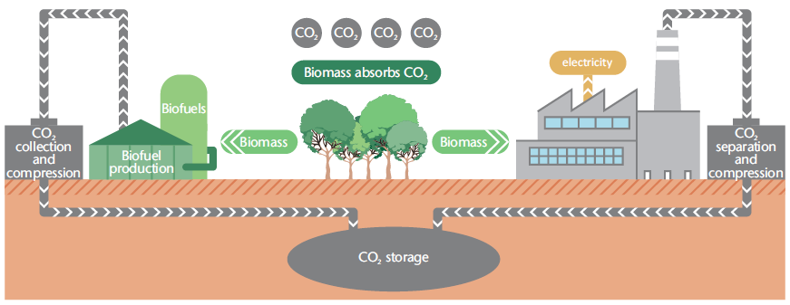
Bioenergy with carbon capture, storage and/or utilisation (BECCS/BECCU)
BECCS/BECCU
BECCS involves the permanent storage of captured CO₂, while bioenergy with carbon capture and utilisation (BECCU) uses the captured CO₂ as a feedstock in the production of energy carriers, chemicals and materials.
BECCS processes provide negative emissions.
BECCU processes can be carbon neutral, but can only provide negative emissions in some limited circumstances, depending on the lifetime and final disposal of the products.
IEA Bioenergy: Task 40, 2020

Slide 8
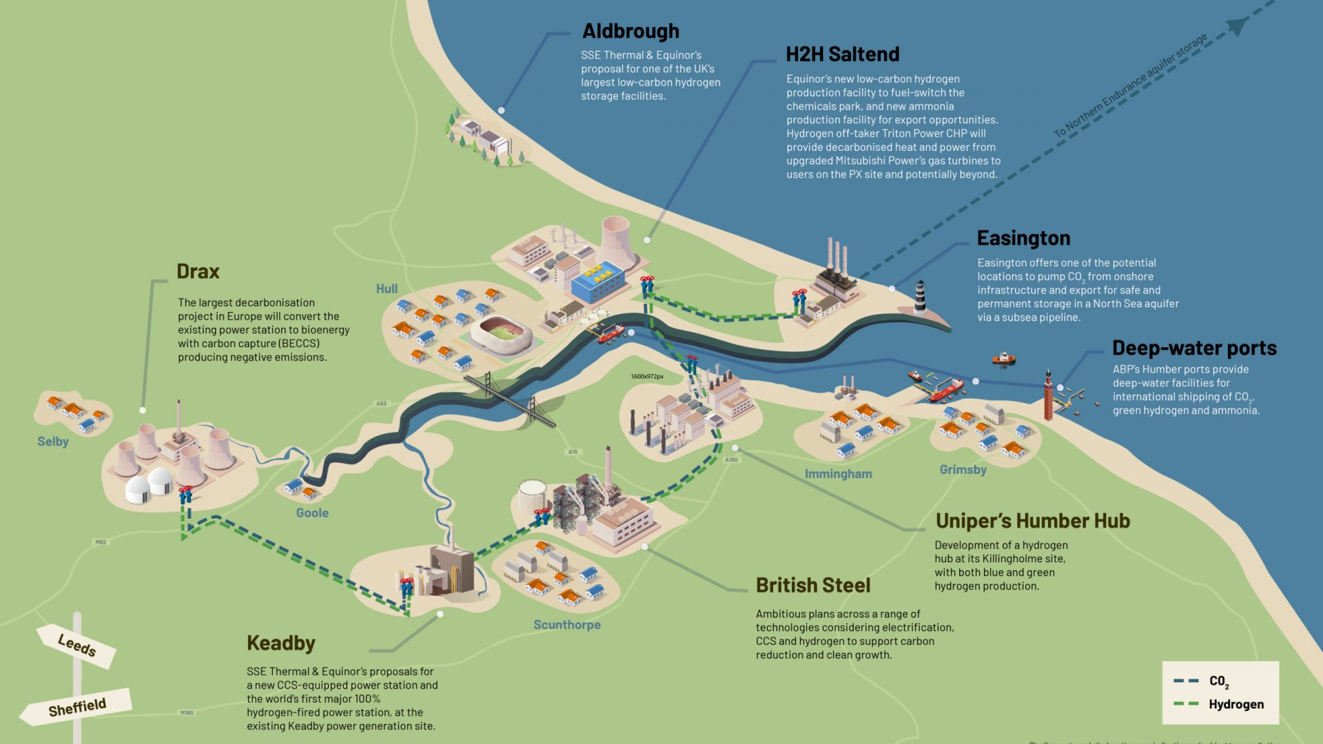
BECCS CASE STUDIES: Drax (UK) & Garray (Spain)
BECCS/BECCU
The level of emissions from BECCS would vary widely, depending on the feedstock used, the land use changes involved, and a variety of other issues associated with the bioenergy value chain (i.e., case studies).
BECCS’ performance can be measured by how much net carbon it captures (carbon efficiency) and how much net energy it produces (energy efficiency) along the whole supply chain.
The cost of CO₂ capture also differs on each route, with the cost of capturing one ton of CO₂ typically lower in biofuel routes than in power routes, because of the higher CO₂ purity in the biomass-to-fuel routes.
Therefore, there are trade-offs to consider when comparing BECCS deployment options.

Slide 9
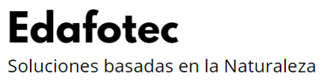
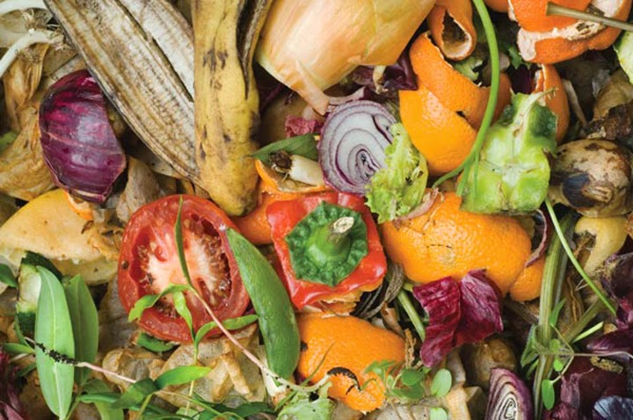
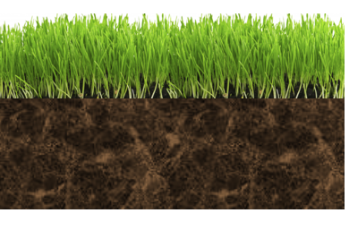
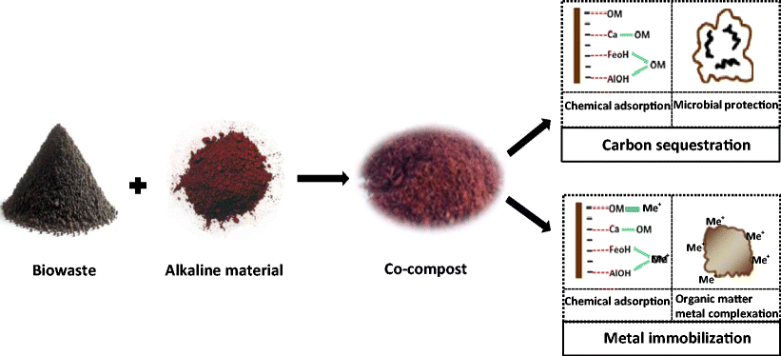
Artificial Soils
Waste
Artificial soils

Slide 10

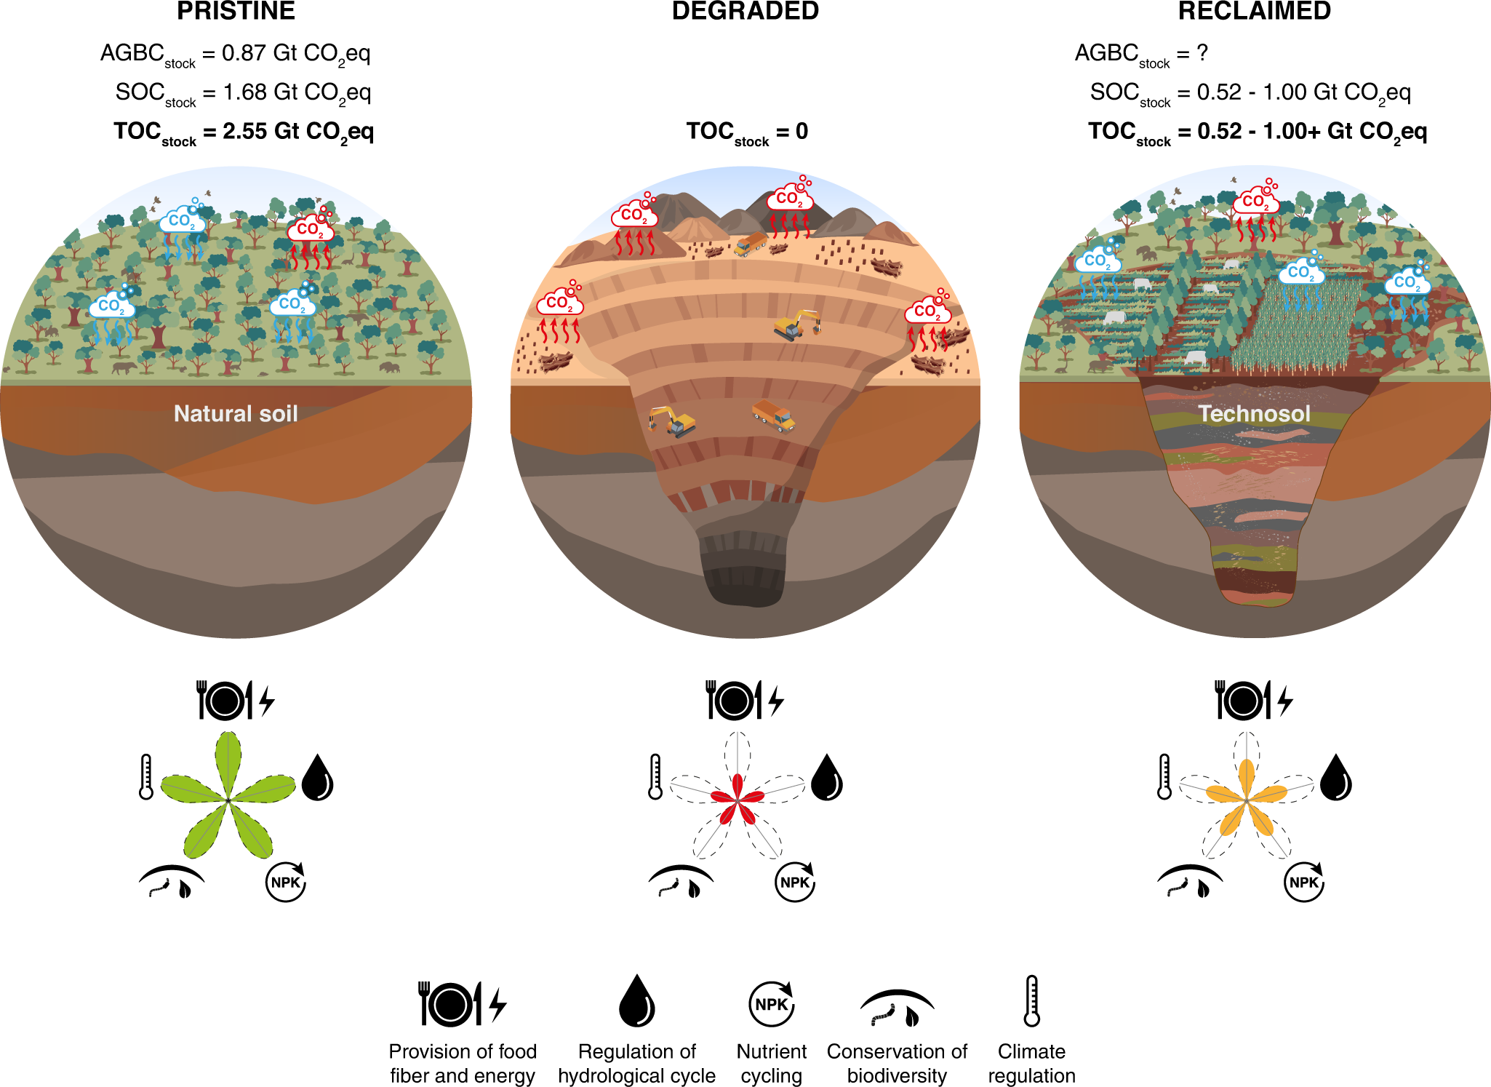
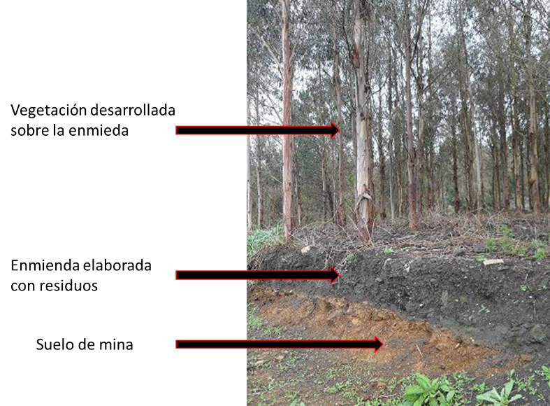
Artificial Soils
Ruiz et al. Constructing soils for climate-smart mining. Commun Earth Environ 4, 219 (2023).

Slide 11
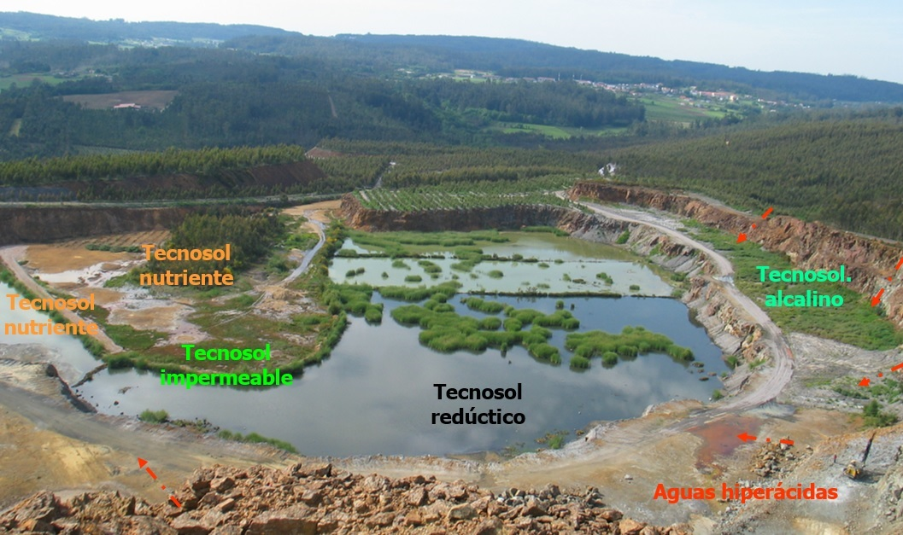
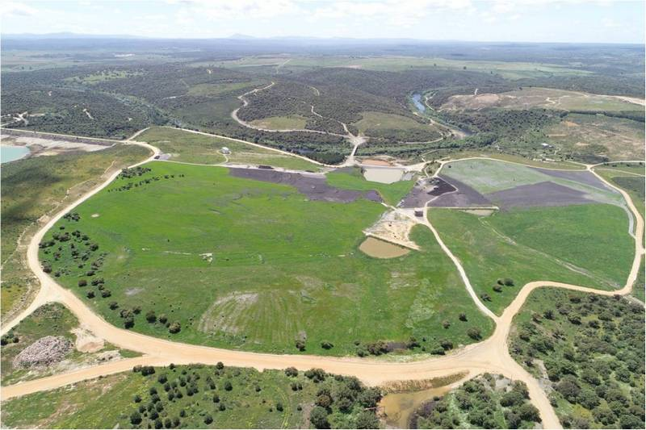
Artificial Soils

Slide 12
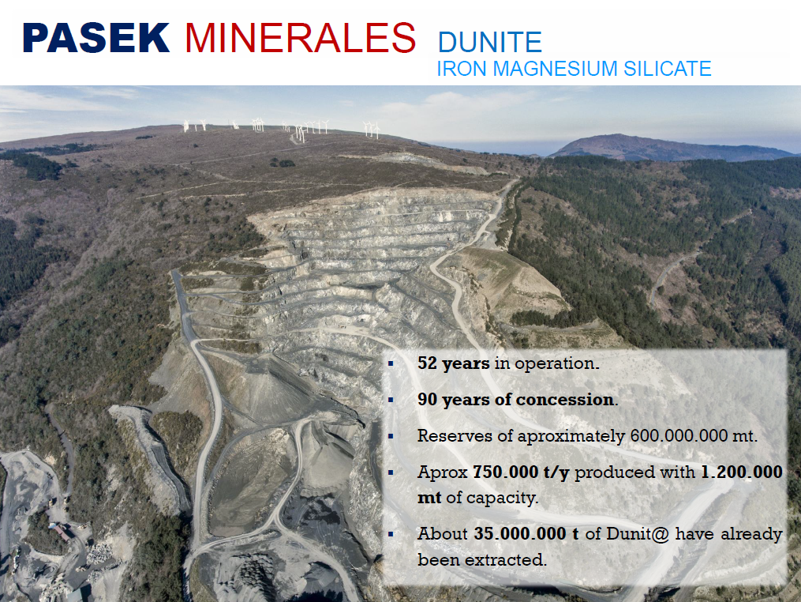
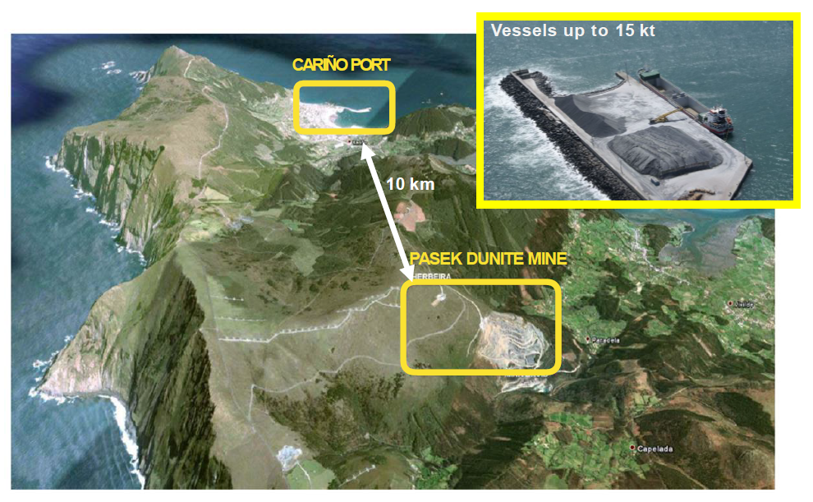
Artificial Soils

Slide 13
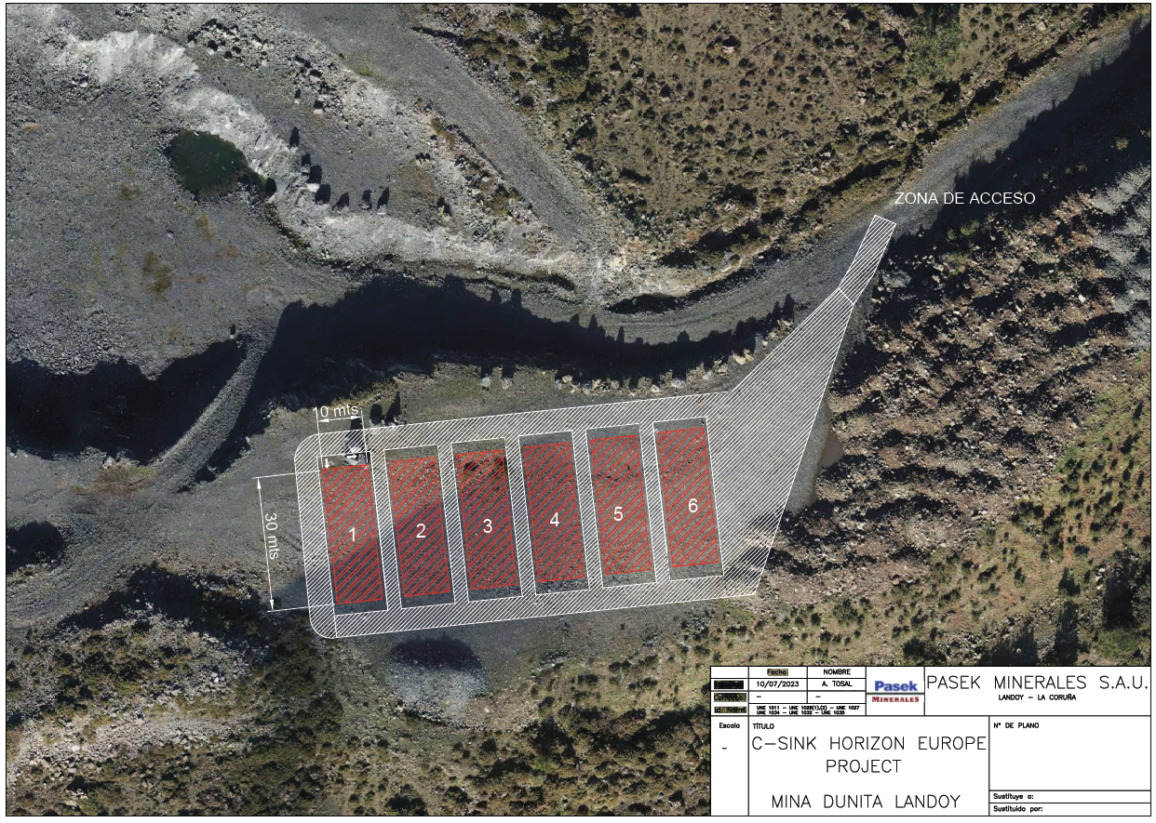
Artificial Soils

Slide 14
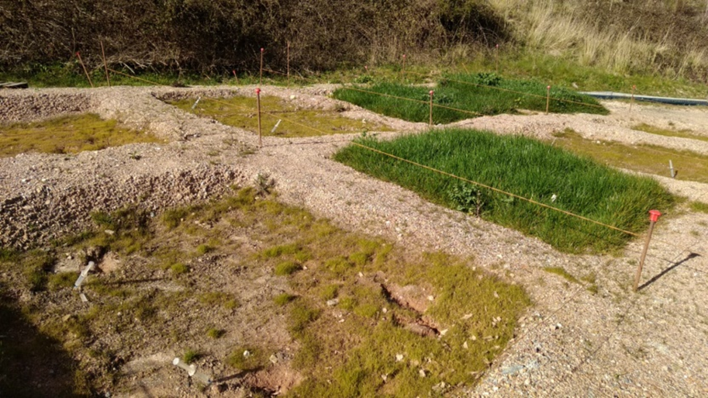
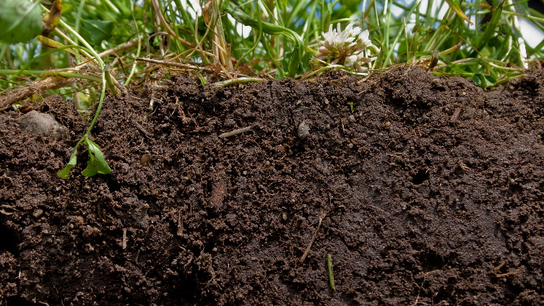
C-Sink Artificial soils team (UNIOVI+ EDAFOTEC+ PASEK)
Edaphic & chemical parameters
Enzymatic, microbial activities
Vegetation growth & physiology
Mineralogy & inorganic carbon
Remote sensing (UAV)
➔ Focus on C-pools
Soil Organic Carbon (SOC) fractionation
C-Isotopes, DOC
Other C-Sink approaches:
Enhanced weathering, biochar, etc.

Slide 15
PrEM Group, CSIC-INCAR
Covadonga Pevida (cpevida@incar.csic.es)
Pasek Minerals
Pamela Díaz (pamela.diaz@pasek.group)
INDUROT (Env. Geochemistry Unit), Univ. de Oviedo
José Luis R. Gallego (jgallego@uniovi.es)

