Slide 2
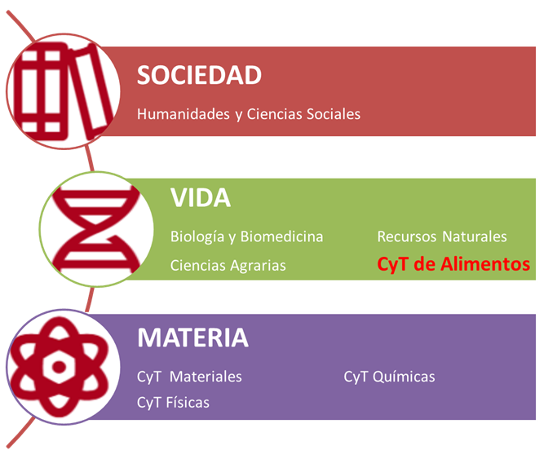
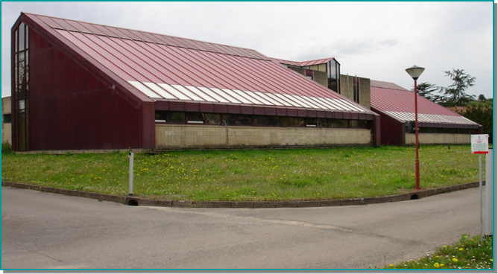
Personal Investigador
Investigadores plantilla | 18
Investigadores contratados | 10
Doctorandos | 13
Técnicos de apoyo | 10
Instituto de Productos Lácteos de Asturias
IPLA-CSIC
Grupos de Investigación
Servicios Científico-Técnicos

Slide 3
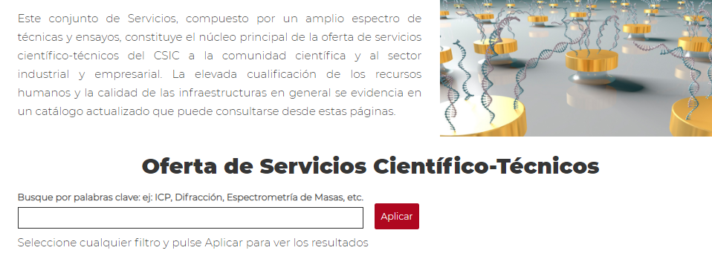
https://www.csic.es/es/investigacion/catalogo-de-servicios-cientifico-tecnico

Slide 4
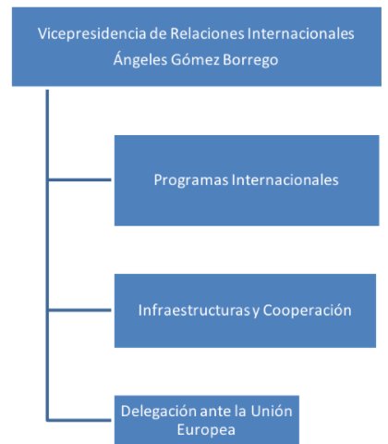
Personal Investigador
Investigadores plantilla | 18
Investigadores contratados | 10
Doctorandos | 13
Técnicos de apoyo | 10
Instituto de Productos Lácteos de Asturias
IPLA-CSIC
Grupos de Investigación
Servicios Cientifico Técnicos

Slide 5
Calidad y seguridad alimentaria
Bioconservación
Reducción uso antibióticos
Alimentos y salud
Probióticos y prebióticos. Alimentos funcionales
Microbiota y microbioma
Nutrición de precisión
Revalorización de subproductos
Reducción desperdicios
Diseño de cultivos iniciadores

Slide 6
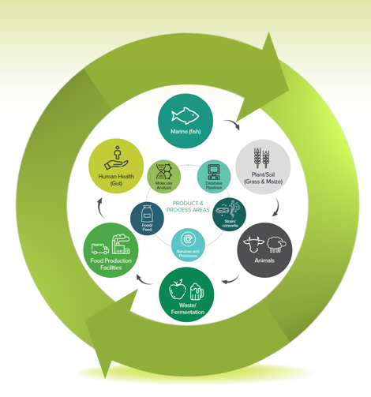
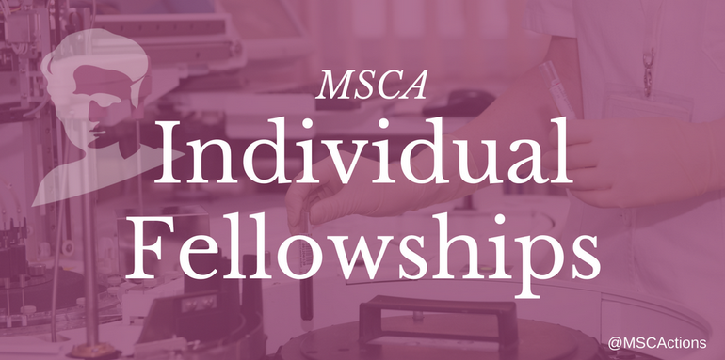
H2020MSCA-ITN
Impact of intrapartum antimicrobial prophylaxis as an early determinant in microbiome development

Slide 7
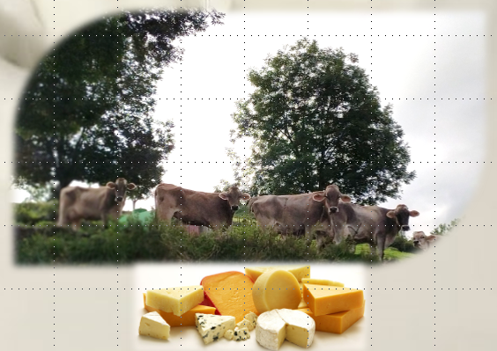
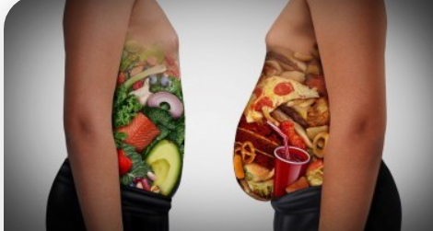
SUDASP
Support for dairy production sector in RIS region
RIMICIA
Review Impact MICrobiome In Assesment
Evaluating the impact on/by gastro-intestinal (GI) tract microbiomes (human and domestic animal) in assessments under EFSA’s
CLIMB-OUT
Child microbes predict how to stay away from obesity

Slide 8
HORIZON CL6
Call: Fair, healthy and environmentally-friendly food systems from primary production to consumption. FARM2F0RK
Type of Action: HORIZON-RIA HORIZON Research and Innovation Actions
HORIZON-CL6-2021-FARM2FORK-01-14 Microbes for healthy and sustainable food and diets
HORIZON-CL6-2021-FARM2FORK-01-16 Identification, assessment and management of existing and emerging food safety issues

Slide 9
HORIZON CL6
Type of Action: HORIZON-RIA HORIZON Research and Innovation Actions
HORIZON-CL6-2022-FARM2FORK-01-13. AU-EU Combatting all forms of malnutrition
HORIZON-CL6-2022-FARM2FORK-01-10. Integrated surveillance system to prevent and reduce diet-related Non Communicable Diseases (NCDs)
Alimentos
Seguridad
Calidad
Salud
Sostenibilidad
HORIZON-CL6-2022-FARM2FORK-01-09. Microbiomes in food production systems
HORIZON-CL6-2021-CIRCBIO-01-07: Microbiomes for bio-based innovation and environmental applications
HORIZON-CL6-2022-FARM2FORK-01-11. Effective systems for authenticity and traceability in the food system

Slide 10
HORIZON CL6
Type of Action: HORIZON-RIA HORIZON Research and Innovation Actions
Microbiología
Omicas
Tecnología de Alimentos
HORIZON-CL6-2022-FARM2FORK-01-13. AU-EU Combatting all forms of malnutrition
HORIZON-CL6-2022-FARM2FORK-01-10. Integrated surveillance system to prevent and reduce diet-related Non Communicable Diseases (NCDs)
HORIZON-CL6-2022-FARM2FORK-01-09. Microbiomes in food production systems
HORIZON-CL6-2021-CIRCBIO-01-07: Microbiomes for bio-based innovation and environmental applications
HORIZON-CL6-2022-FARM2FORK-01-11. Effective systems for authenticity and traceability in the food system

